Slide 1
How to work with JMeter Performance Testing

Slide 2
JMeter
Why JMeter?
To understand why JMeter is the most popular Performance testing tool, let’s have a look at these six reasons:
1. Free of Cost
JMeter is free of cost, has a friendly interface, and allows users to automate their work.
2. Performance Testing of Applications
JMeter helps in the performance testing of both static and dynamic resources. Static resources like HTML and JavaScript, and dynamic resources such as JSP, Servlets, and AJAX.

Slide 3
Load Testing and Stress Testing
Performance testing in JMeter includes load testing and stress testing. Hence, it identifies the maximum concurrent users that the server can handle.
4. . Framework
The framework in JMeter allows multi-threading, which means several separate thread groups may perform simultaneous and concurrent sampling.
5. Graphical Analysis
JMeter enables the performance testing representation in a graphical format like the graph, tree, table, report, etc., making the analysis representable and interesting.
6. Platform Independent
Since JMeter is entirely Java-based, it can be used across any platform or server to run a Java Virtual Machine.

Slide 4
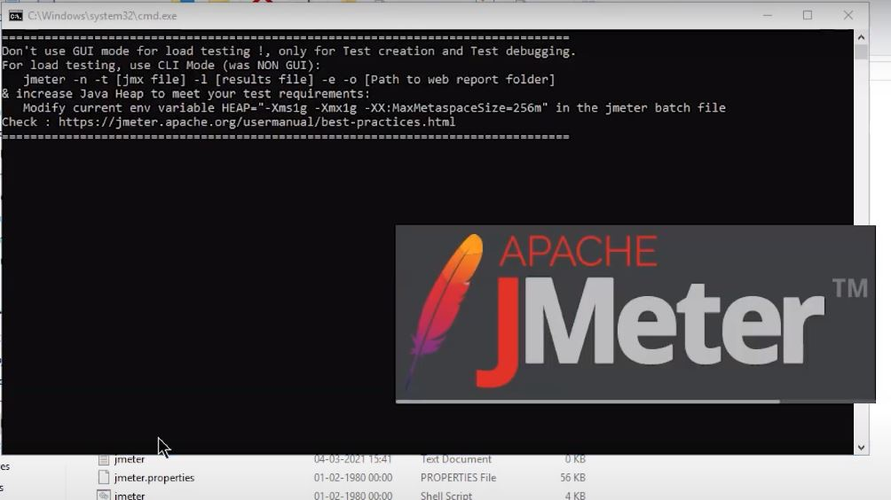
JMeter Performance Testing
Here you will see the process to perform JMeter Performance Testing in 5 steps:
1. Setting up Apache JMeter
The first step is to go to the Apache JMeter folder
Go inside the bin folder
Select the JMeter .bat file
Double click on this file

Slide 5
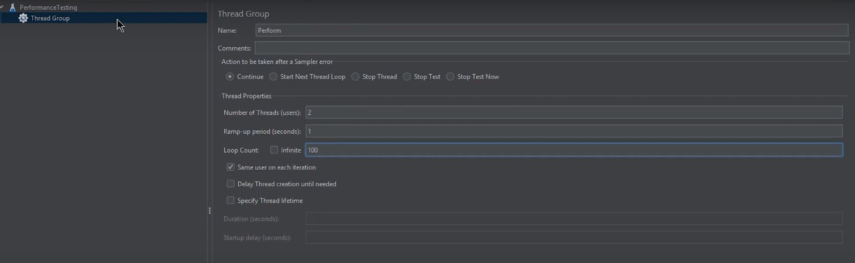
Here, the test plan is renamed as performance testing.
2. Adding a Thread Group
Right-click on the Performance Testing
Go to add, then go to Threads (Users) and select Thread Group
It has several options, like
Action to be taken after there is an error: you can choose it the way you want
Then, there is a “number of threads” where you can choose the number of users you want
Then, there is a “ramp-up period in seconds” that states the time gap between the users' hits
There is a “loop count” option where you can choose how many times the test will run for the number of users. You can also choose the test to run infinite times
There is also a scheduler here to help you schedule the start time and the test’s end time
For now, make the number of threads to be 2. And loop count to be 100

Slide 6
3. Adding HTTP Request
Right-click on the Thread group, go to add option and go to the sampler option
In the menu that appears, select the HTTP request option
You can see a Server Name or IP box; it will give the server name or the IP in that.
This demo will use Simplilearn's website, here.
Go to Simplilearn's website
Copy the URL from here
Come back to the JMeter window
Paste the URL in the Server Name box
Don't give http or HTTPS since these are protocols that will come in the other box and that will be automatically taken in the http request case.
In the path dialog box, leave a forward slash

Slide 7
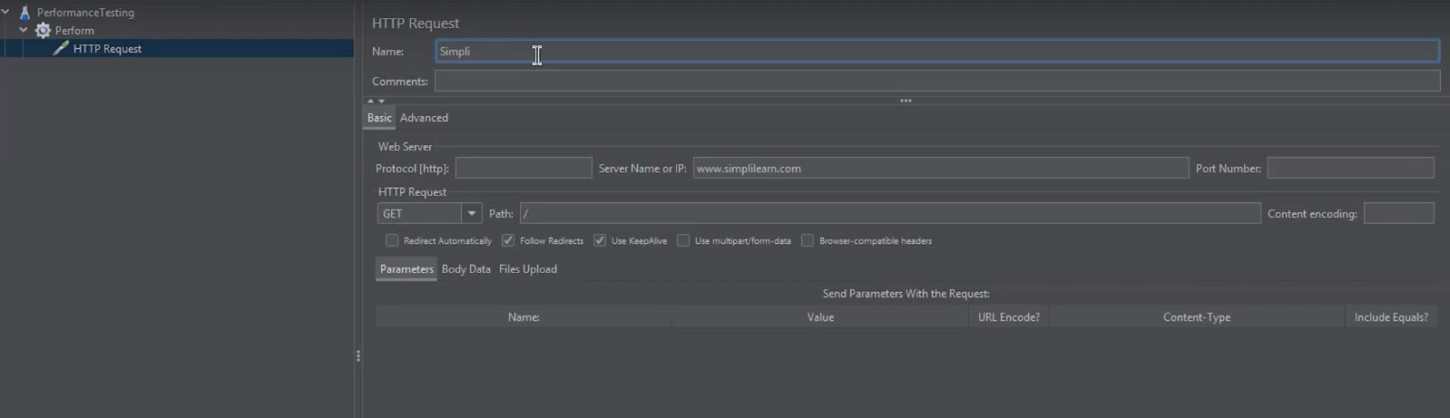
The forward slash is used since the aim is to access the route page.
Here, this demo will rename this HTTP request as Simple.
Now, to get results, let's add listeners. Listeners are something that is used to provide the outputs of a load test. There are different types of listeners present in JMeter, and a good deal may be added using plugins.

Slide 8
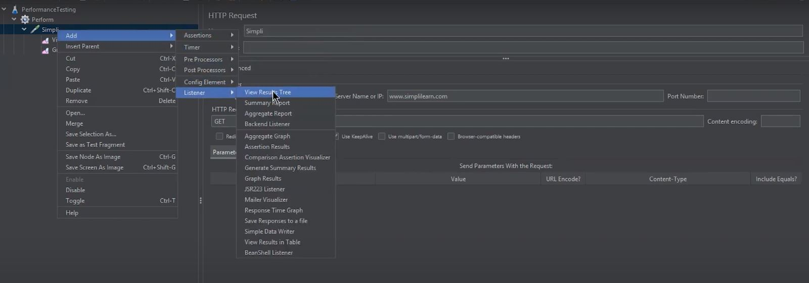
4. Adding Listeners
You can use three different listeners here to have an idea about the representation that the JMeter provides
Right-click on the Thread Group
Go to Add, select the Listener option, and go for the view Results in Tree option

Slide 9
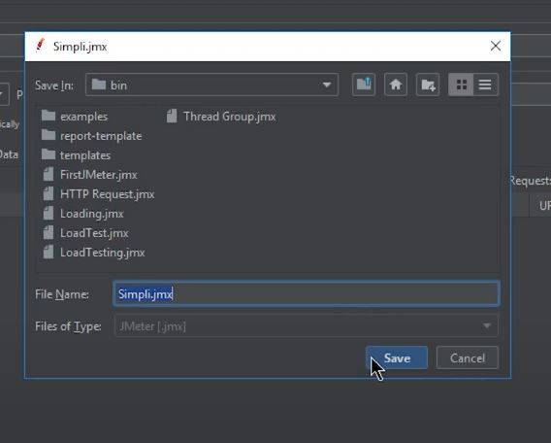
Again, right-click on the listener option and choose graph results
And for the third listener, right-click again and select the View Results in Table option
Now, it's time to run the test.
5. Running the Test
Save this JMeter test

Slide 10
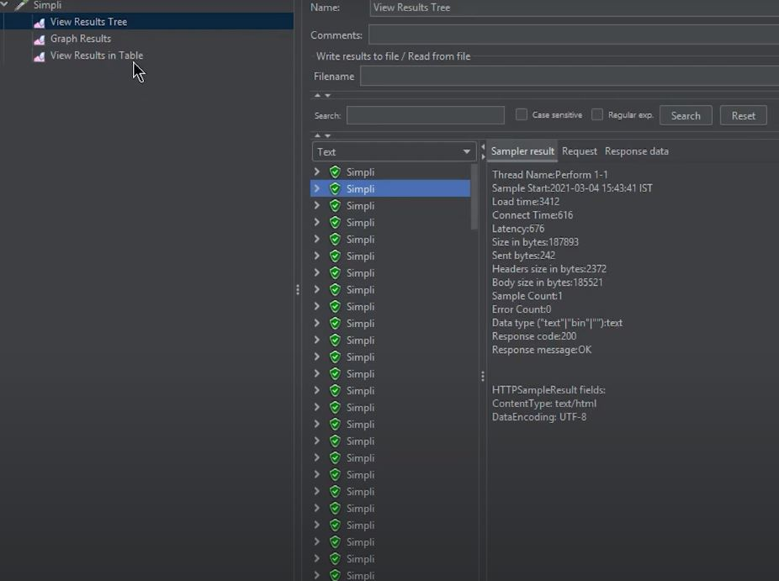
Click the green button and run the test
Now when you visit the "View Results Tree," you can see the test running. Same with graph results. Then you can also see the time the test has been executing.

Slide 11
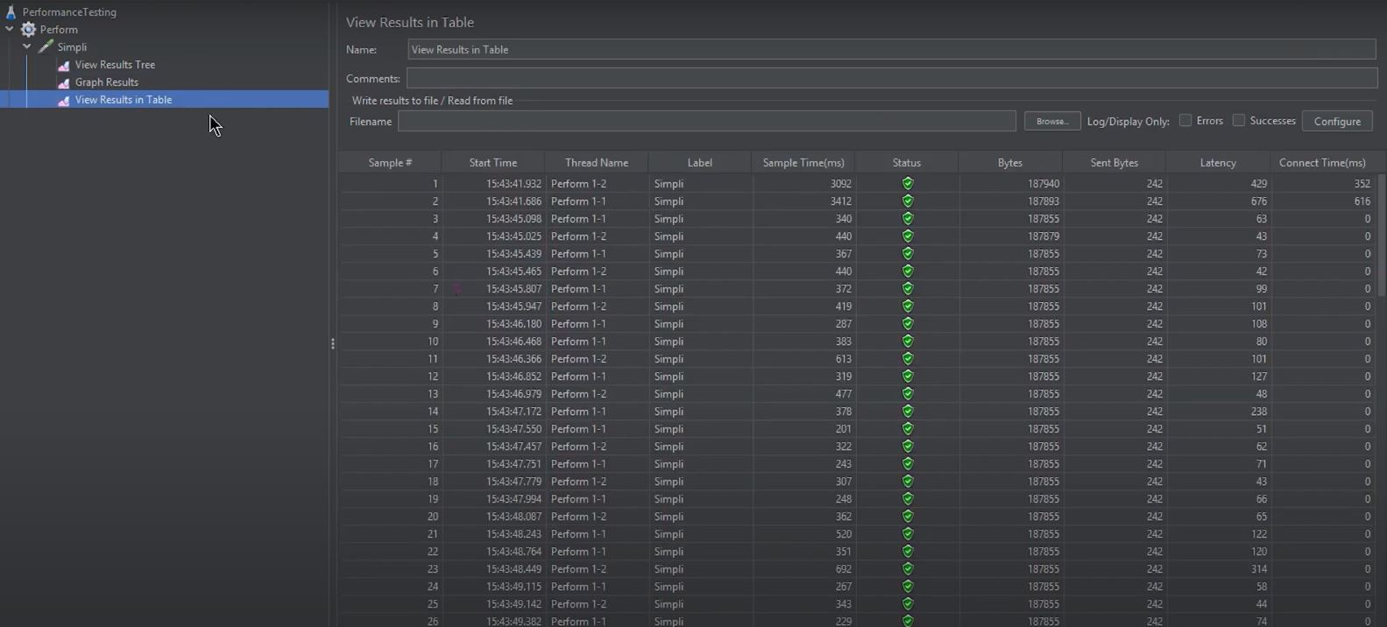
You can see the thread name, label, Sample Time per second, Bytes, Sort Bytes, and the latency.
Then, in the tree option, you can see several performance testing metrics clicking on any of the tests. And in the graph results, you can see
the graph coming on the screen now,

Slide 12
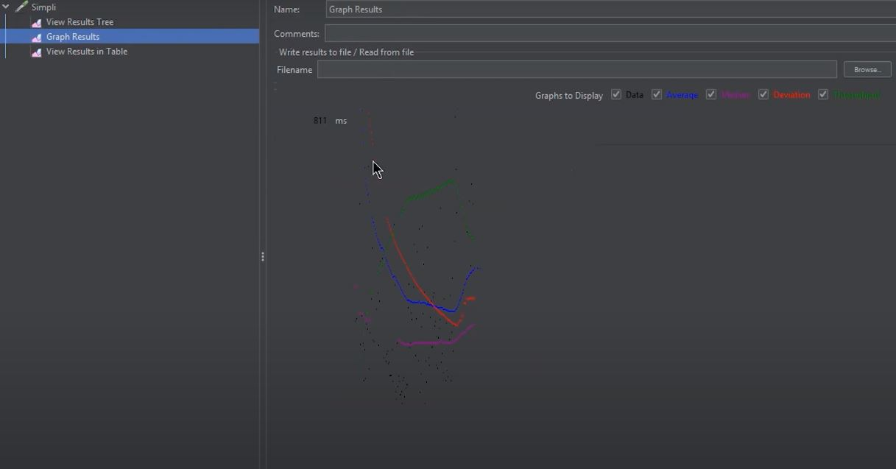
representing the tests taking place concerning the IP address, thread, and loop counts.
So, what JMeter exactly does is, creates a request and sends it to the server. Once it receives the server's response, it collects them and visualizes those details in a chart or graph. After that, it processes the server's response, and finally, it generates the test results in several formats such as TXT, XML, JSON so that the tester can analyze data.

